Slide 1
Vectors

Slide 2
Scalars and Vectors
A scalar is a single number that represents a magnitude
  E.g. distance, mass, speed, temperature, etc.
A vector is a set of numbers that describe both a magnitude and direction
  E.g. velocity (the magnitude of velocity is speed), force, momentum, etc.
Notation: a vector-valued variable is differentiated from a scalar one by using bold or the following symbol:
A

Slide 3
Characteristics of Vectors
A Vector is something that has two and only two defining characteristics:
Magnitude: the measure of'quantity‘ that gives a number and its standard unit
Direction: North, South, East, West

Slide 4
Direction
Speed vs. Velocity
Speed is a scalar, (magnitude no direction) - such as 5 meter per second or 5m/s
Speed does not tell the direction the object is moving. All that we know from the speed is the magnitude of the movement.
Velocity, is a vector (both magnitude and direction) – such as 5 m/s East. It tells you the magnitude of the movement, 5 m/s, as well as the direction which is Eastward.

Slide 5
Represent the following:
A = 5 cm, East
N
E

Slide 6
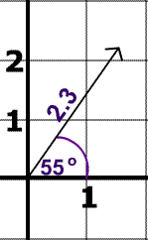
Example
The direction of the vector is 55° North of East
The magnitude of the vector is 2.3.

Slide 7
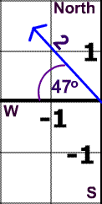
Now You Try
Direction:
Magnitude:
47° North of West
2

Slide 8
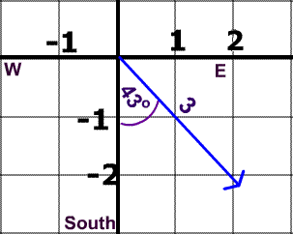
Try Again
Direction:
Magnitude:
43° East of South
3

Slide 9
Try Again
It is also possible to describe this vector's direction as 47 South of East.
Why?

Slide 10




Adding Vectors
Add vectors A and B

Slide 11
Adding Vectors
On a graph, add vectors using the “head-to-tail” rule:
Move B so that the head of A touches the tail of B
Note: “moving” B does not change it. A vector is only defined by its magnitude and direction, not starting location.

Slide 12
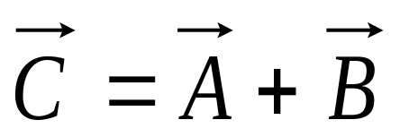

Adding Vectors
The vector starting at the tail of A and ending at the head of B is C, the sum (or resultant) of A and B.

Slide 13
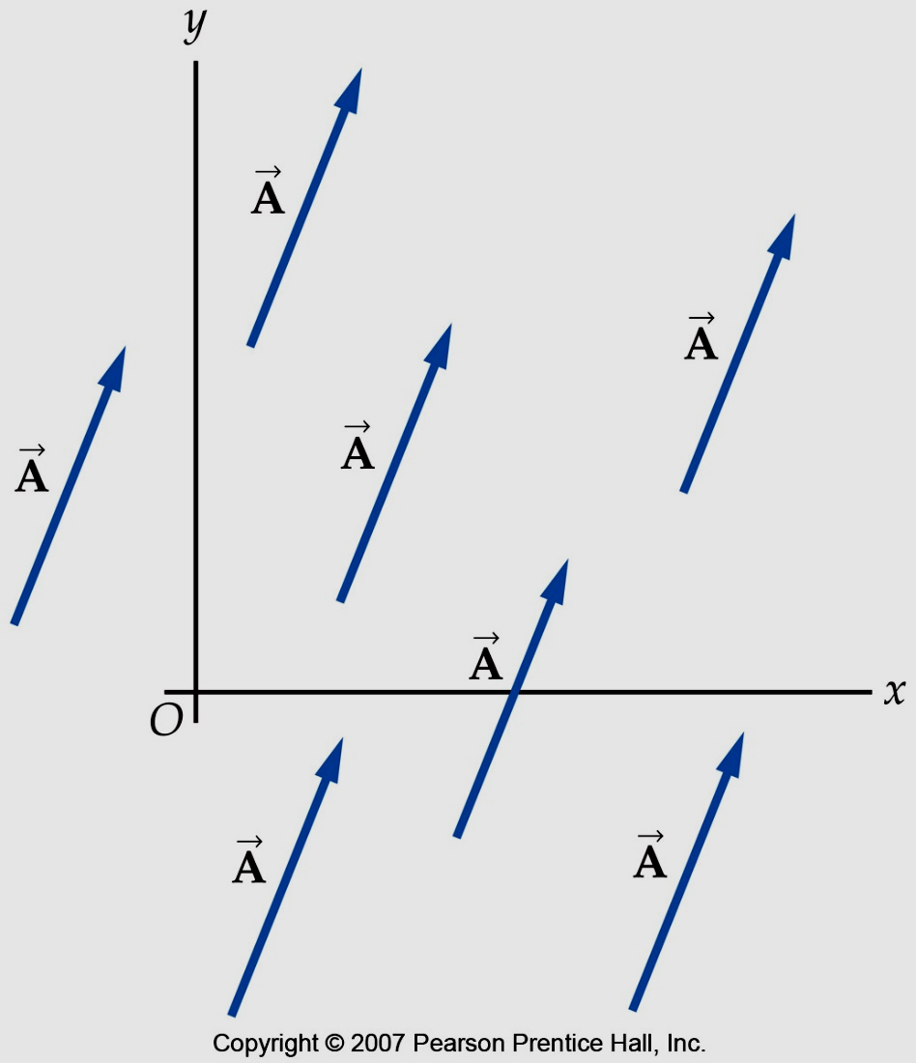
Adding Vectors
Note: moving a vector does not change it. A vector is only defined by its magnitude and direction, not starting location

Slide 14


Adding Vectors
Let’s go back to our example:
Now our vectors have values.

Slide 15
Adding Vectors
What is the value of our resultant?

Slide 16
Using Polygon Method
Choose a convenient scale, draw the first vector, and connect the rest of the vectors head-to-tail
The resultant R extends from the tail of the first vector to the head of the last vector. Measure the length of R using a ruler and the direction by a protractor

Slide 17
Adding Vectors
What is the value of our resultant?
scale: 1cm : 1cm
= 3cm, 45 ̊ North of East

Slide 18
Using Component Method
Resolve the given vectors into their x and y components using trigonometry
After resolving, get the sum of all x components and all y components
Using Pythagorean theorem, determine the magnitude of the resultant using the sum of x and y

Slide 19
Using Component Method
Find the angle using tangent function and determine the direction using the signs of the sum of x and y components. A negative sum of the x components signifies direction along the west while the positive sum indicates directions along the east. For y, negative signifies along the south and positive for north.

Slide 20
Find the resultant of the following vectors using component method
N = 5.00N East
C = 2.00 N 60 ̊ North of East
Y = 3.00 N 40 ̊ North of West

Slide 21
Seatwork 1
Given the following vectors:
L = 6.00 N, East
A = 10.0 N 30 ̊ North of East
S = 12.0 N 20 ̊ North of West
Using component method, find the resultant vector
Draw the vectors using graphical method

Slide 22
Vector Subtraction
In subtraction of vectors, simply get the opposite direction of the vector to be subtracted from another vector and proceed to addition of vectors.

Slide 23
Example
Using the polygon method, find D = N – C – Y
Where:
N = 5.0 N East
C = 2.0 N 60 ̊ North of East
Y = 3.0 N 40 ̊ North of West
Scale: 1 N : 1cm

Slide 24
Product of Vectors
Scalar Product or Dot product
A • B
A • B = ABcosθ = |A||B|cosθ
* If θ is between zero and 90 ̊ the dot product is positive;when θ is between 90̊ and 180̊, it’s negative, when θ is equal to 90̊ , the dot product is zero and when θ is zero, its cosine is equal to one

Slide 25
A • B = A_{x}B_{x} + A_{y}B_{y} + A_{z}B_{z}
ABcosθ = A_{x}B_{x} + A_{y}B_{y} + A_{z}B_{z}

Slide 26
The scalar product of two perpendicular vector is always zero.
j
k
i

Slide 27
Sample Problem
What is the angle between A = 2i + 4j and B = -i -2k

Slide 28

Find the scalar product of A • B of two vectors. The magnitudes are A=4.00 and B = 5.00
Y
130ᵒ
B
A
53ᵒ
X

Slide 29
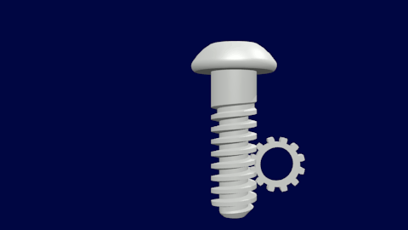
Vector Product
Vector product or cross product
A x B
C = A x B
C = ABsinθ (magnitude of the vector cross product of A and B)
* If θ is 0̊ and 180̊ , the cross product is zero, when θ is 90̊ its sine is equal to one.

Slide 30
A x B = (A_{y}B_{z} – A_{z}B_{y})i + (A_{z}B_{x} – A_{x}B_{z})j +
(A_{x}B_{y} – A_{y}B_{x})k
ABsinθ = (A_{y}B_{z} – A_{z}B_{y})i + (A_{z}B_{x} – A_{x}B_{z})j +
(A_{x}B_{y} – A_{y}B_{x})k

Slide 31
The cross product of between angle 0 and 180 is always zero.
j
k
i

Slide 32
Given N = 5i – 4j + k and O = i -4j +8k. Find the
Cross product
Angle between two vectors

